Slide 1

4 Managing the Global Business portfolio
HBP# FO0014

Slide 2
Managing the Global Business portfolio
Segment/customer behavior
Channel conflict
Competitive behavior
Pricing decisions
Marker Motion’s performance
Market conditions
Investment decisions
Use of market research

Slide 3
Managing the Global Business portfolio
Managing markets
Managing market segments
Managing customers

Slide 4
Link Between Customer Expectations, MM’s AI Performance, and Satisfaction
Past performance/ quality
Expectations
Needs, values, and satisfaction with past performance
Negative disconfirmation
Satisfaction
Positive disconfirmation
Perceived performance/ quality
Disconfirmation = Performance — Expectations

Slide 5
Understanding the Market
Mature market:
Approximately 5% growth per year (not explosive market growth)
Competitive marketplace
Over 100 general and specialized manufacturers
MM facing market loss and margin pressures
Technology-intensive products
Periodic product performance enhancements to keep up with gradual (but continually increasing) customer demands

Slide 6
Impact of Investment Decisions
There is a continual struggle between the short and long term
Profits = revenues – cost
Investments typically increase cots in the short-run but increase revenues over time.
As a result, if large scale investments are made
The investments will have downward pressure on profits
Lower profits means that management will cut the budget
Lower budget can impact the ability to sustain higher effort
Net result: such an investment strategy is not sustainable

Slide 7
AI Impact of Investment Decisions (continued)
A long-term relationship-building strategy works when you
Understand the interplay between immediate and lagged effects of your investment decisions
Understand that you cannot go after all segments
Carefully pick the segments/customers you want to serve
Craft and implement all elements of your marketing effort to go after the segments selected
If done correctly, the simulation rewards any effort to build long-term relationships (loyalty) with customers

Slide 8
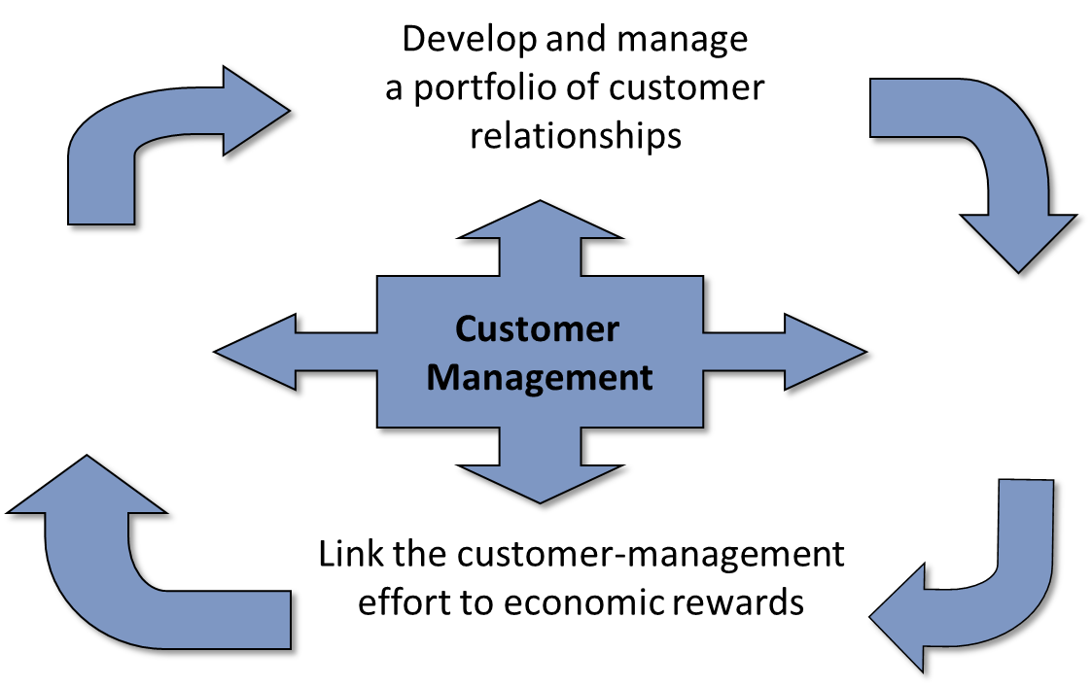
Customer Management Process

Slide 9
Customer Behavior
Needs evolve very slowly
Importance of different attributes does not change much over time
Customers change expectations when vendors change performance
Satisfaction = f(Performance, (Expectations – Performance))
How well you performed
How well you performed relative to my expectations
Expectations = f(Past Performance)
What I expect from you is based on how well you did last time

Slide 10
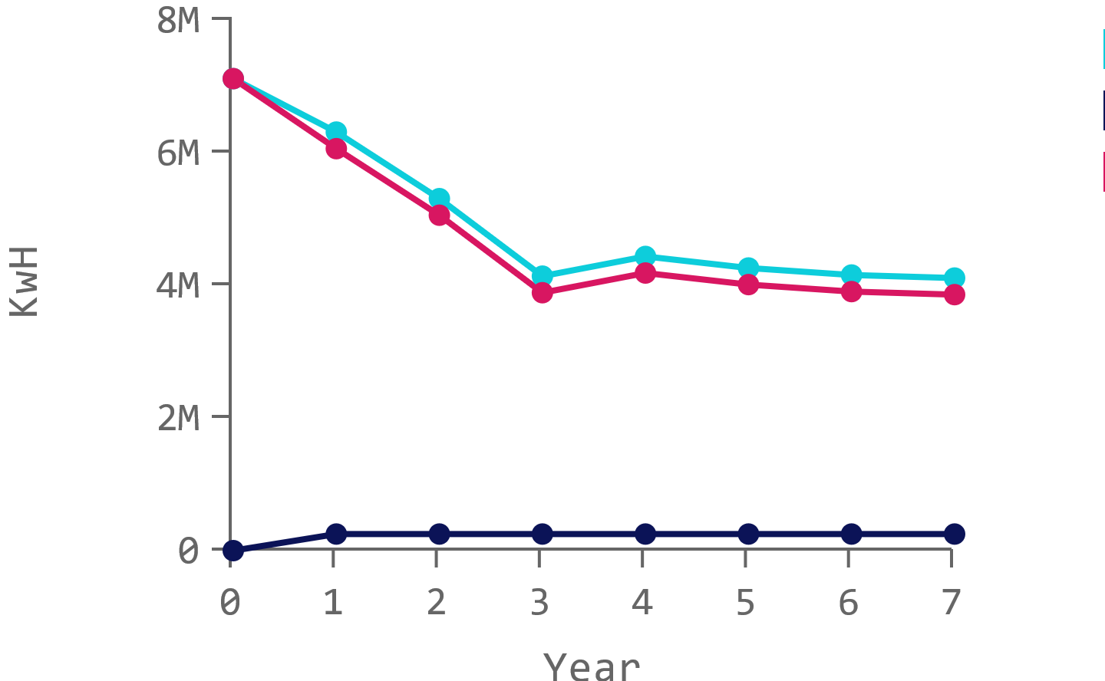
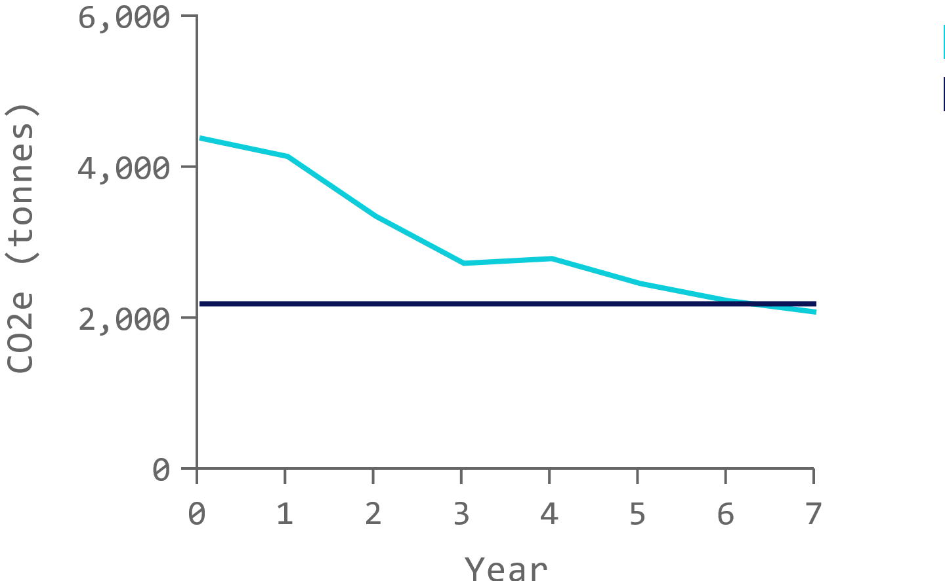
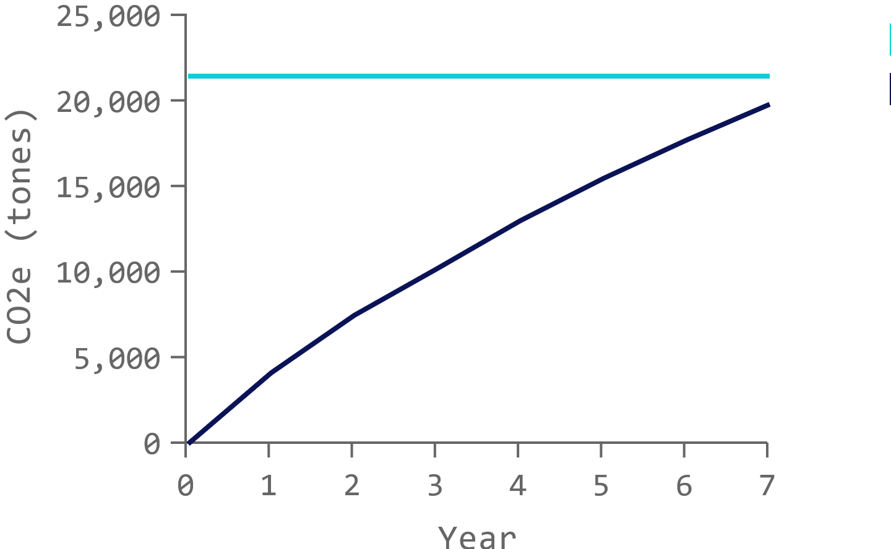
Recap of Results
Chances of success
Consistent investing
Combine risk impact
The low-investment anomaly
Annual investment vs. Final Year Target
Amount at stake vs capital & Budget
As previously mentioned in the abstract, cash is king.
The board of directors and top management should invest in international R&D and try diversification.
Did revenues and profits increase?

